Slide 1
CO456 Web - most materials adapted from Moseley (2006), Chapters 2, 3 & 4 -
Unit 3
Recap (tables, images, forms)
… and some CSS …

Slide 2
Module schedule
Wk. | Lecture/subject area(s) | Practical | Reading (Moseley, 2007)
1 | Introduction How the Web works | Internet/Web definitions and HTML report | Ch 1 (The way the Web works)
2 | HTML 1 (Introductory - inc. lists and hyperlinks) | HTML | Ch 2 pp 24-36 (HTML)
3 | HTML 2 (inc. tables, images and forms) | HTML | Ch 2 pp 36-48 (HTML) Ch 3 (XHTML and frames)
4 | CSS 1 (Introduction and core CSS principles) | CSS – introductory styles, embedded styles. | Ch 4 pp 76-96.
5 | CSS 2 (Positioning elements). | CSS– using IDs, classes and layout control. | Ch 4 pp 97-103.
6 | CSS 3 (Advanced layout & navigation) | CSS – using CSS to produce button-like navigation from HTML list elements. (CW2a to be demonstrated). | Specialised articles.
7 | JavaScript 1 (Fundamentals, variables) | JS – foundation constructs. | Ch 5 pp 108-116
8 | JavaScript 2 (Functions, branches, loops). | JS – calling functions. | Ch 5 pp 117-124.
9 | JavaScript 3 (Objects and the DOM). | JS – manipulating the DOM. | Ch 6 126-139.
10 | JavaScript 4 (Forms and validation). And DHTML | JS– validating user completed forms. | Ch 6 139-145, Ch 7.
11 | HTML5, CSS3, - media, forms, gradients, SVG (‘Edge’) and other enhancements | Web frameworks taster session 1 | See practical sheets for information sources
12 | Advanced HTML5, CSS3 & JS frameworks (e.g. jQuery, jQuery Mobile, Box2DWeb) | Web frameworks taster session 2 | See practical sheets for information sources
 | Vacation
13 | Assignment workshop 1 | Assignment workshop 1 | N/A
14 | Assignment workshop 2 | Assignment workshop 2 | N/A

Slide 3
Tables - in summary
Covered last week
Key tags are <table>, <tr>, <th> and <td>
Common <table> attributes are
border=“1”
width=“n pixels/n%”
cellpadding – in pixels between inner cell wall and cell content (now superseded by CSS)
cellspacing – in pixels between cells (now superseded by CSS)
rules=“all”
Two useful <th> and <td> attributes for irregular tables are
colspan=“n cols” – merges cells horizontally
rowspan=“n rows” – merges cells vertically

Slide 4
Images - in summary
Covered by independent study last week – brief review below
The image tag, source, height (opt), width (opt), alternative text (opt)
<img src=“url/path/file.ext” height=“px/%” width=“px/%” alt=“My pic”>
Can also be used for background
<body background=“duck.jpg>
… and for hyperlinks
<a href=“somePlace.html”><img src= …></a>
… and embedded as background styles in other tags
<form action="processor.php" method="post" style="background-image:url(duck.jpg)">
… remember – in-line styles are generally not ‘good practice’
Click here for an example of all the above, use “view source”

Slide 5
Forms - in summary
Covered by independent study last week – brief review below
The form tag with action and method attributes
<form action="processThisPlease.php" method="post">
The input tag for collecting user data – many “type” values
<input type=“text/password/checkbox/radio/file/submit/button/reset/hidden”>
<body background=“duck.jpg>
And other tags including
Text areas <textarea name=“comments” rows=“10” columns =“70” wrap=“wrap”>a message can go here</textarea>
Drop down menus <select><option value=“slct1”>Opt 1<option><option value=“slct2”>Opt 2<option><option value=“slct3”>Opt 3<option></select>
Click here for the earlier example but this time examine the form tags

Slide 6
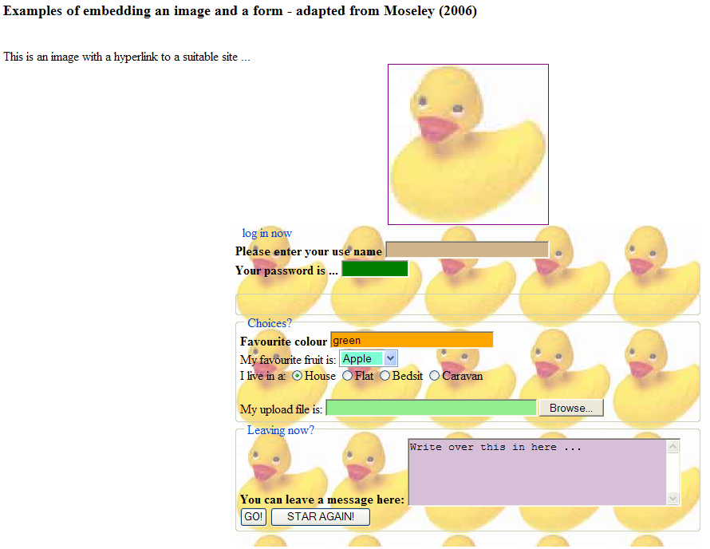
Screen capture of image and form example (please follow links on earlier slides for “code”)

Slide 7
CSS
Original HTML was concerned purely with structural markup
Early 1990s HTML expanded to include presentation markup
Confusion of structure and presentational elements
Difficult to engineer, maintain and reuse
Poor search engine indexing
Inconsistent browser interpretation
CSS1 standardised by the World Wide Web Consortium (W3C) in 1996
CSS2, an extension of CSS1 w/o major changes, standardised in 1998
An example: the html
The html: <h1>The main heading</h1>
The CSS to control the html: h1 { color : red ; font : italic 10em Times, serif; text-decoration: underline; background: black; }
Click here for the example of using CSS to control appearance of an <h1> tag

Slide 8
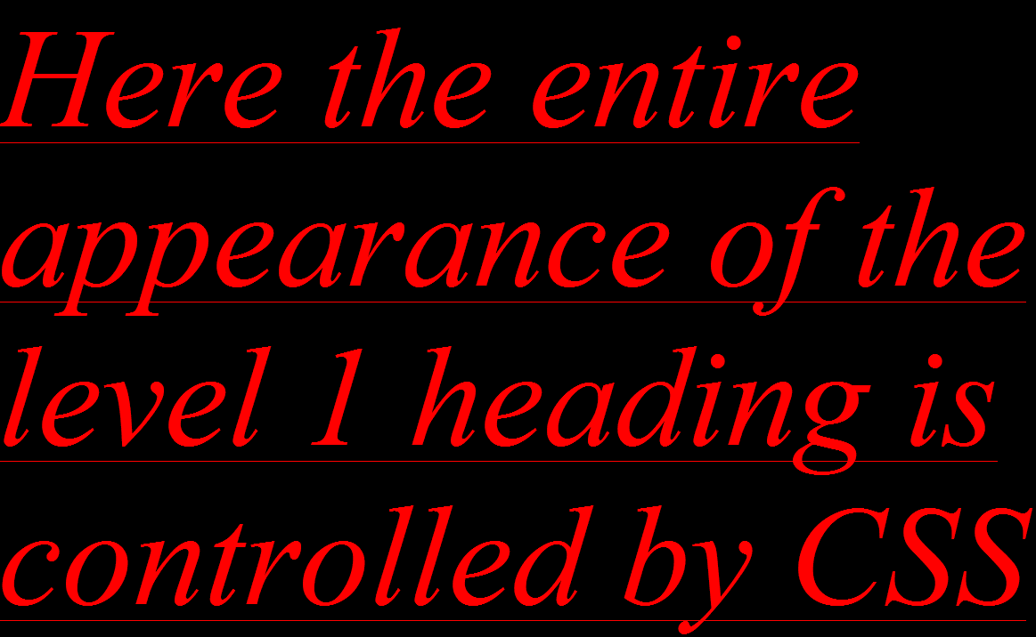
Screen capture of CSS style of <h1> tag (please follow links on earlier slide for “code”)

Slide 9
CSS – rules
The basic rule
selector {property 1 : value 1 ; property 2 : value 2 ; …. }
The selector is the identifier of the element followed by a list of paired property values in curly brackets
e.g. body {color : yellow }
Values with multiple words must be enclosed in quotes
p {font-family : “sans serif”}
Paired property values are separated with semicolons
p {text-align : center ; color : red }
It is possible to apply the same properties to many selectors – in this case level 1 and 2 headings and paragraph tags
h1, h2, p { color : red ; font : italic 10em Times, serif; text-decoration: underline; background: black; }

Slide 10
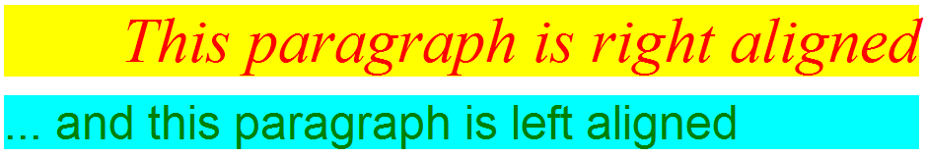
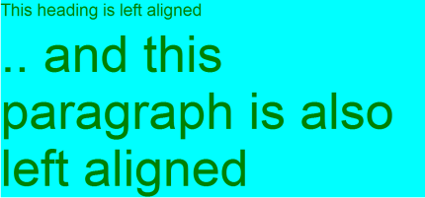
CSS - classes
You can create your own style rules AND you may also have more than one rule for the same element
p.right { text-align : right ; color : red ; font : italic 4em Times , serif ; background: yellow}
p.left { text-align: left; color : green; font : 3em Arial, sans-serif ; background : aqua}
To use
<p class=“right”>This paragraph is right aligned</p>
<p class=“left”>… and this paragraph is left aligned</p>
Click here for the html example using multiple classes to control a <p> tag
A useful technique is to use anonymous classes that may then be applied to multiple tag types – simply don’t specify the tag
.left { text-align: left; color : green; font : 3em Arial, sans-serif ; background : aqua}
To use
<h1 class=“left”>This heading is left aligned</p>
<p class=“left”>… and this paragraph is left aligned</p>
Click here for the html example of applying an anonymous class to 2 tags

Slide 11

CSS – the “id” selector
Similarly to classes - you can create styles for “identified” elements
p#bluepara { text-align : center; color : darkblue ; font: 3em Arial, sans-serif ; background : aqua}
p#greenpara { text-align : center; color : darkgreen ; font : 3em Arial, sans-serif ; background : lightgreen}
To use
<p id=“bluepara”>This is a BLUE paragraph</p>
<p id=“greenpara”>… and here is a GREEN one</p>
Click here for the html example using different identifiers to style a <p> tag
The difference between class and id is that class may apply to many parts of one page but id can be used once only
Although it is also possible to have anonymous identifiers as follows …
#myBlueStyle {color : darkblue ; background : aqua}
… strictly, style rules say one should not apply this to more than one tag in the same page - however it does seem to work in IE Explorer … click here
id selectors are particularly appropriate for styling layouts with the <div> tag (see later)

Slide 12
CSS – pseudo-class selectors
Some classes represent objects that can have different states/behaviour
One example is the HTML anchor tag <a href=“http://www..../my.html”>
a:link {color : red}
a:active {color : coral}
a:visited {color : green; font-weight : bold}
a:hover {color : yellow}
To use
<a href=“myLink”>This text will be red/coral/green depending if not visited/active/visited</a>
Click here for an example using anchor pseudoclasses

Slide 13
Using CSS Hayes D (2002) and Moseley (2006)
THREE CSS TYPES –
linked = style properties are stored in a separate file that is referenced by a <link> tag within the <head> tags. This is a true “separation of content and presentation”;
embedded = style properties are included in <style> tags at the top of pages;
inline = style properties are included in <other> HTML tags throughout a page.
WHY “CASCADING”? – Describes the order of precedence – if style for an element is described in more than one place, web browser will cascade precedence (express or over-ride) to the style closest to the <tag> affected. Order of precedence is: inline > embedded > linked.

Slide 14
Cascading Style Sheets (examples) Hayes D (2002) and Moseley (2006)
INLINE – Simplest but problematic - when updated, every occurrence must be changed. E.g. adding a style attribute to a <table> tag. Useful for “exceptions”.
<table style=“background:aqua” width=“100%”>
EMBEDDED – Better separation of presentation from content, only have to update at the top of a (each) web page. Useful for testing – CSS and HTML on same page
<head><style type="text/css">
body {font-family: Trebuchet MS, Arial; color: blue; font-size: 12; background-color: Thistle}
h1 {color: red; background-color: #00ff00} h2 {color: green}
p {background-color: rgb(250,0,255)}
</style></head>
LINKED – Best separation of presentation from content, only have to update in one file for all pages referenced using the <link> tag. E.g.
<head>
<link rel=“stylesheet” href=“myGreatStyles.css” type=“text/css”>
</head>

Slide 15
CSS – more “tricks”
Many more elements may be manipulated using CSS. Examples include - see Moseley (2006) Chapter 4 or an alternative text for more:
background images, colours and properties;
text colour, decoration, indentation, case, fonts;
borders, boxes, margins, padding;
lists – important but contentious - form the basis of CSS button-like / image less navigation (see later)
Later we will also look at using CSS for styling layout and navigation.

